Slide 1
Compare EKF&NAVSAT vs Lio-sam
EKF & NAVSAT_TRANSFORM
Lio-sam
발표자 : 이담

Slide 2
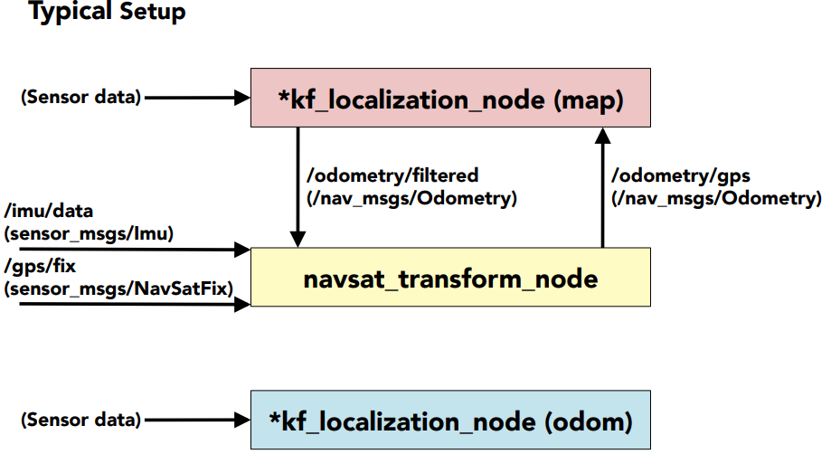
Drone_localization typical setup (rqt_topic)
/velodyne_lidar/fix (sensor_msgs/NavSatFix)
/velodyne_lidar/imu (sensor_msgs/imu)
/odometry/gps (nav_msgs/Odometry)
/odometry/filtered (nav_smgs/Odometry)
/lio_sam/mapping/odometry (nav_msgs/Odometry)

Slide 3
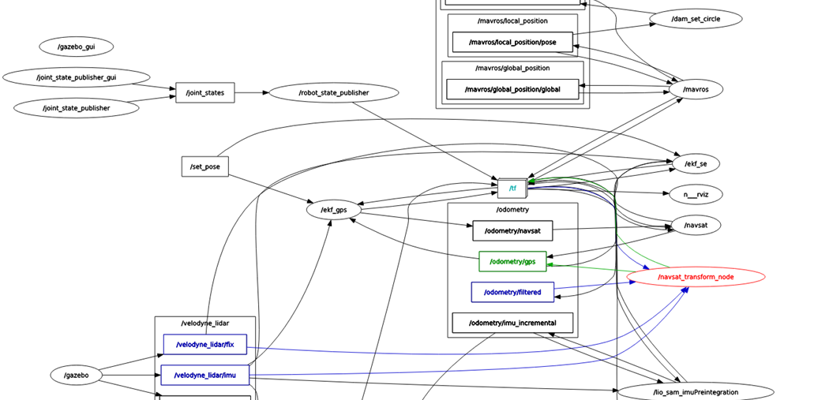
Navsat

Slide 4
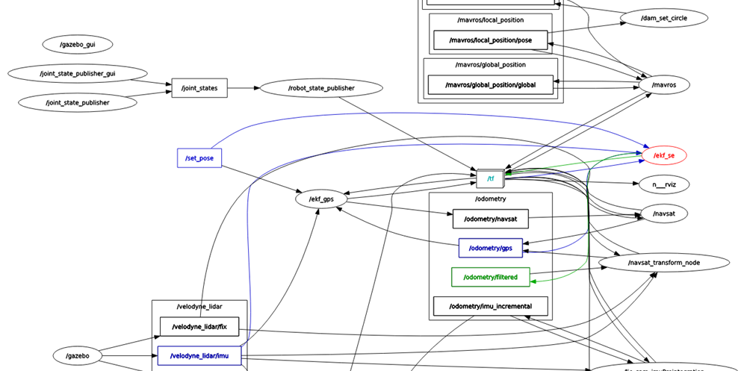
EKF

Slide 5
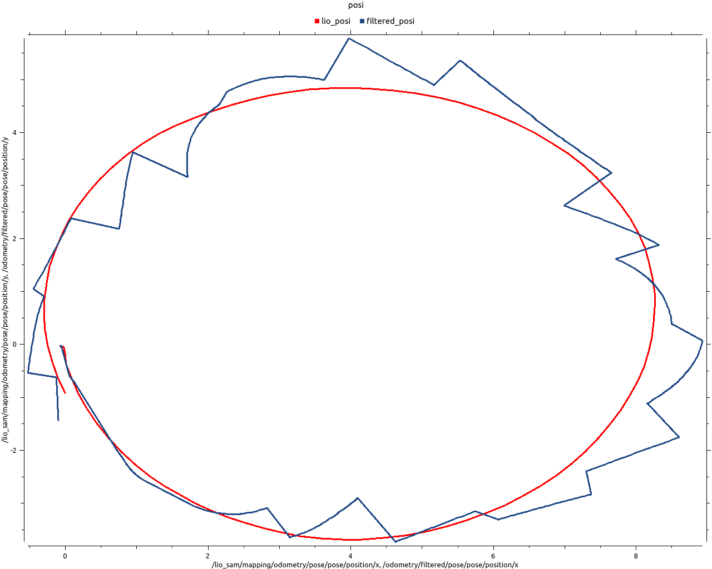
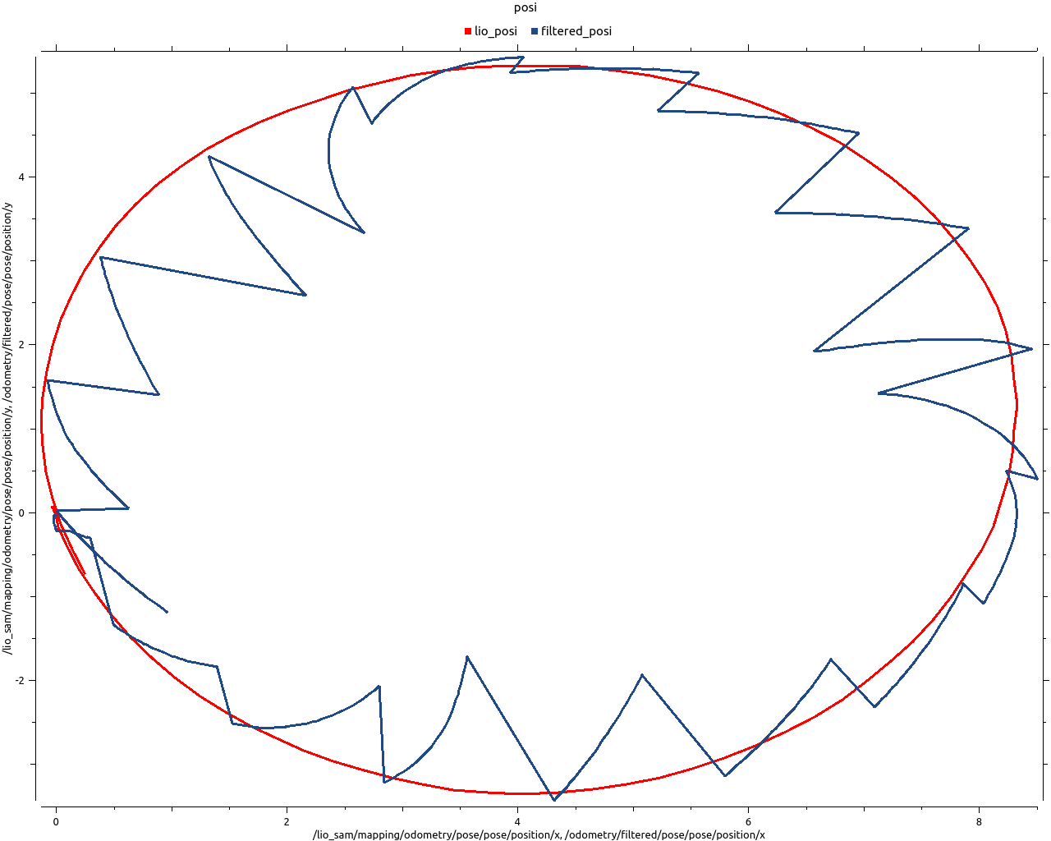
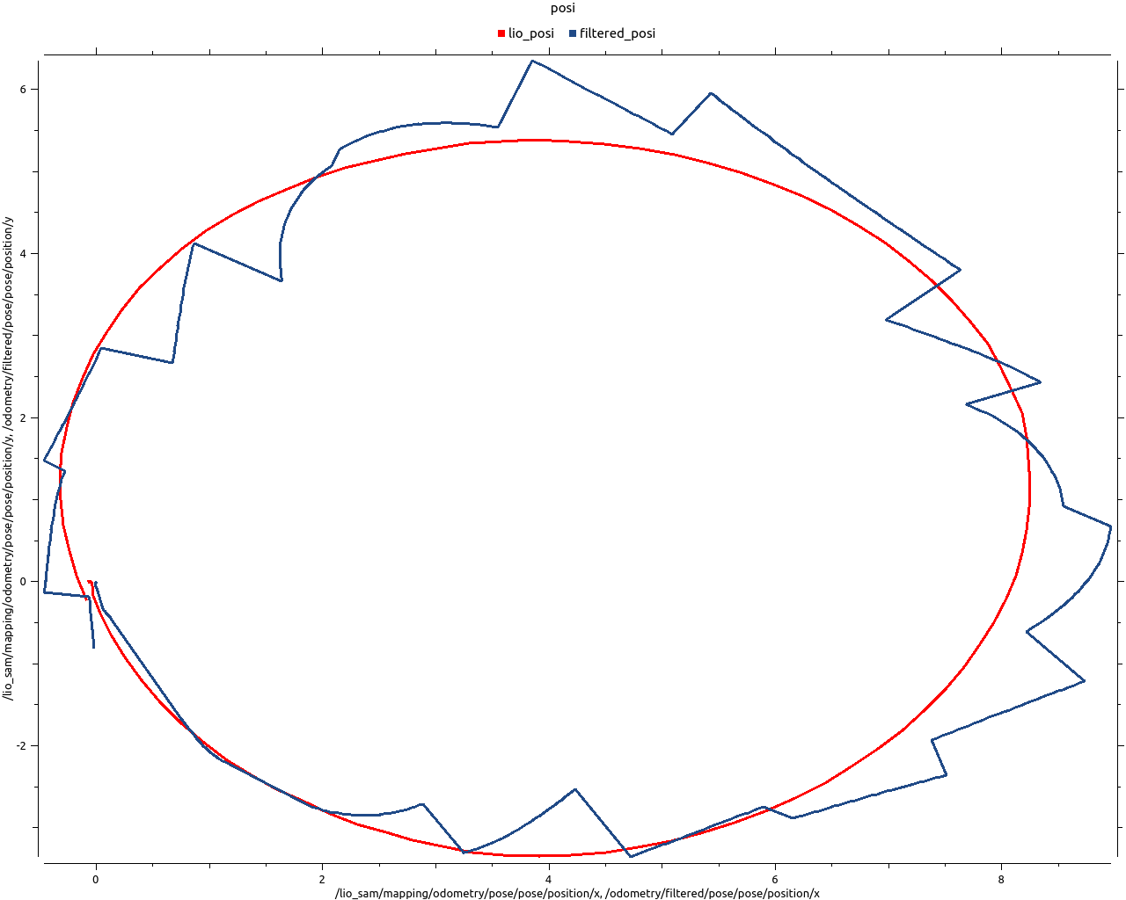
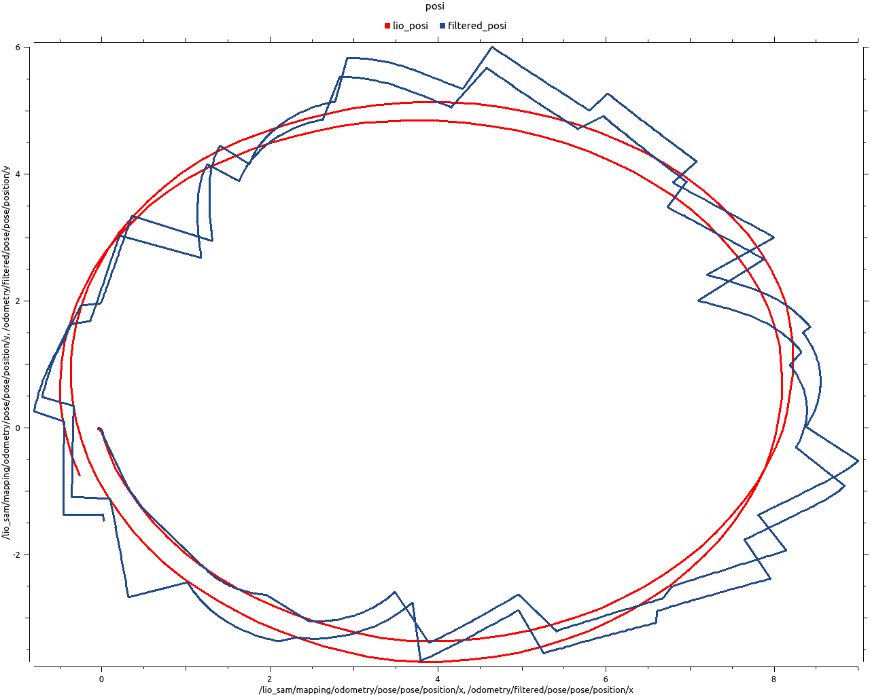
Edit yaml file > Parameter
Imu 값은 계속 받아오는 방면, gps의 값은 한 번씩 받아와서 아래와 같음
Pic. origin
Pic. covariance
Pic. worldframe
Pic. queue

Slide 6
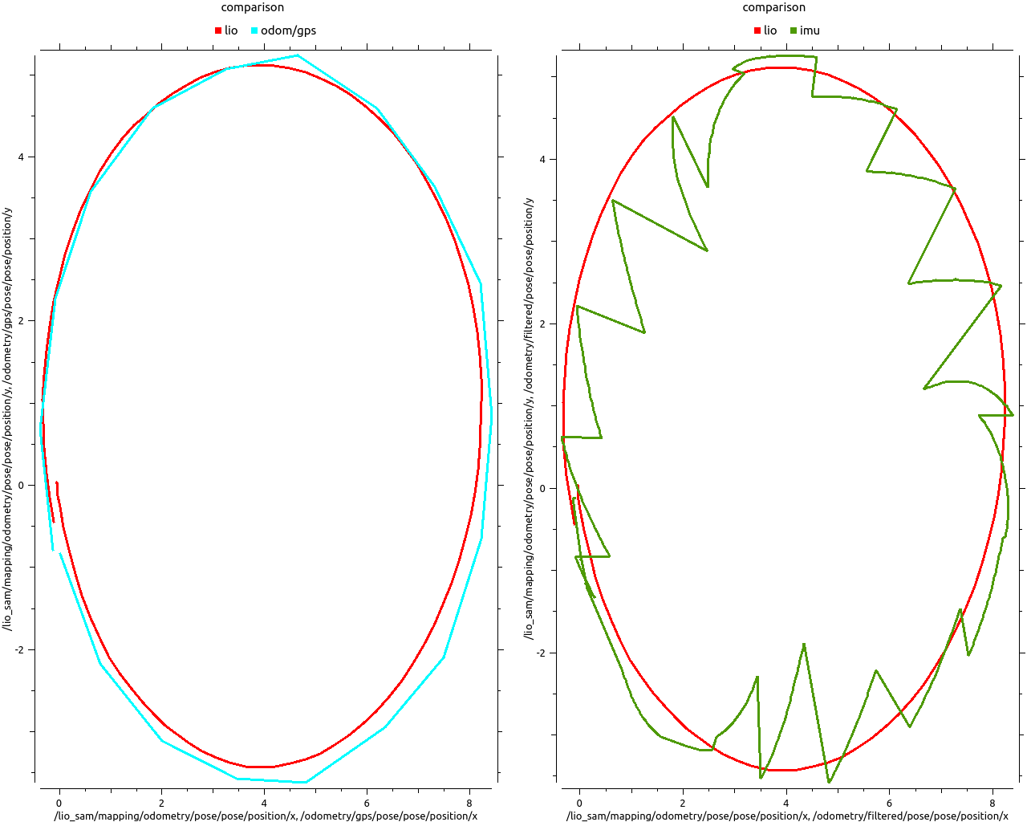
Edit sensorbase.xacro file > Sensor Update Rate setting IMU 100 / GPS 1

Slide 7
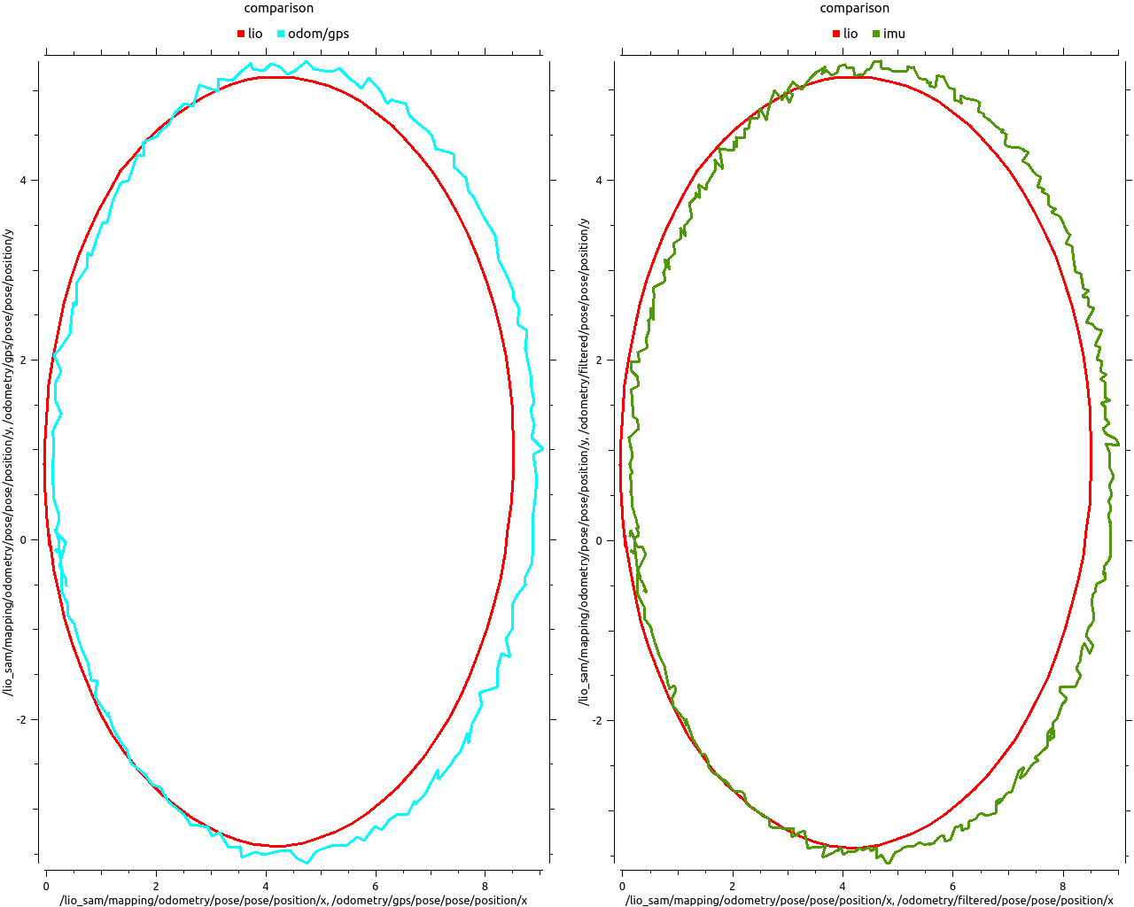
Edit sensorbase.xacro file > Sensor Update Rate setting IMU 100 / GPS 10

Slide 8
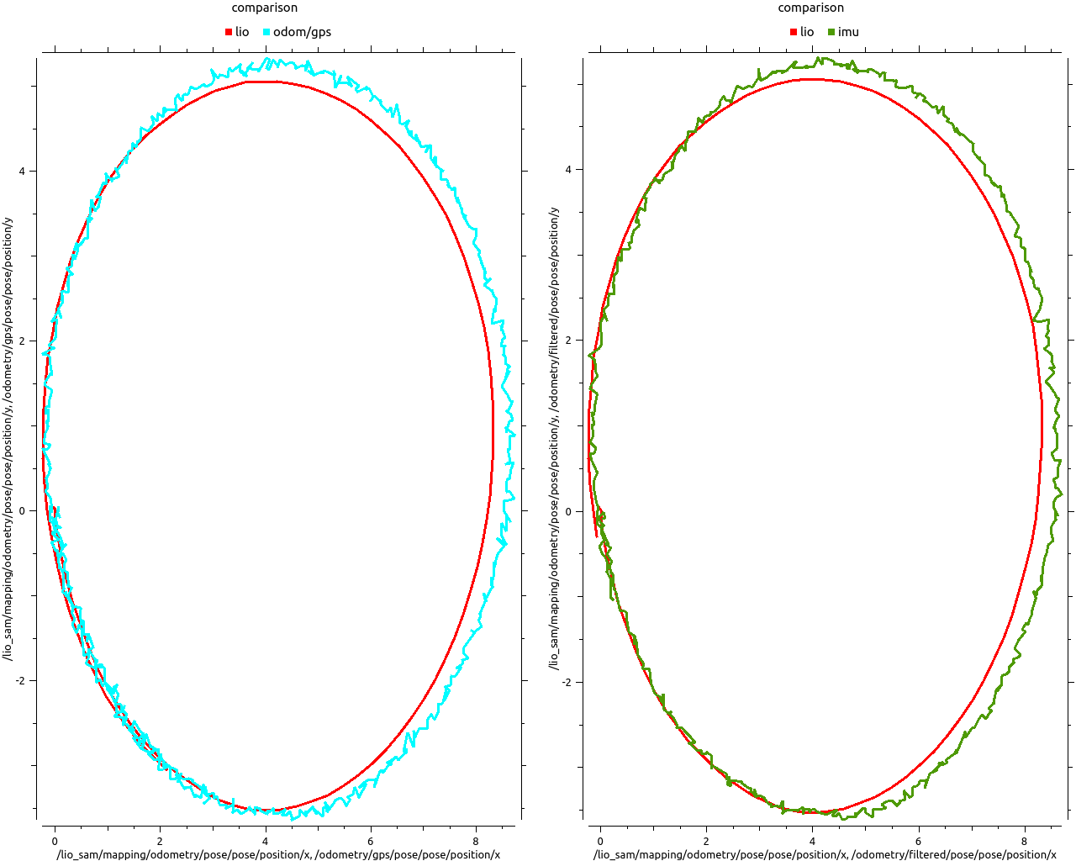
Edit sensorbase.xacro file > Sensor Update Rate setting IMU 100 / GPS 50

Slide 9
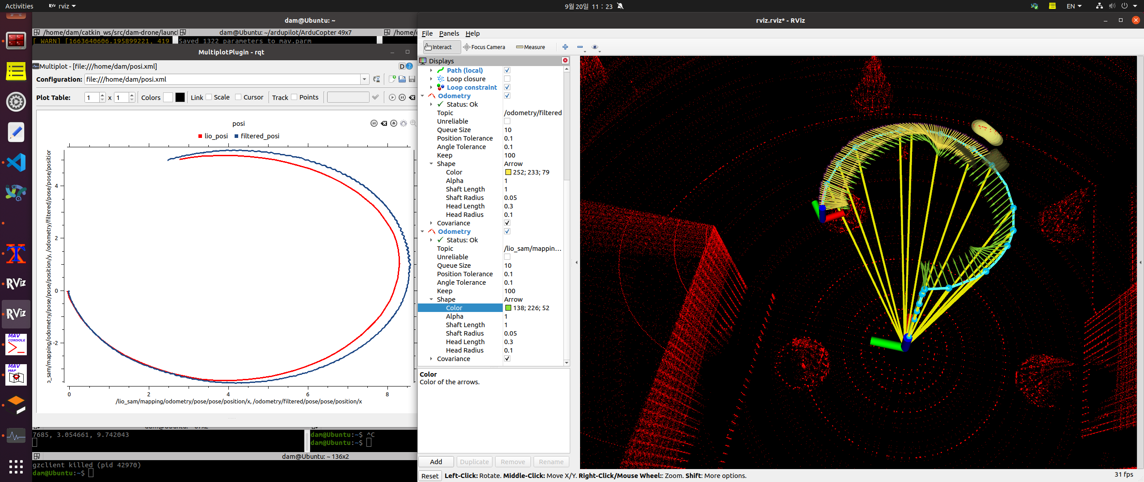
Update rate setting but, 방향 안맞음
Pic. Initial pose after setting update rate

Slide 10
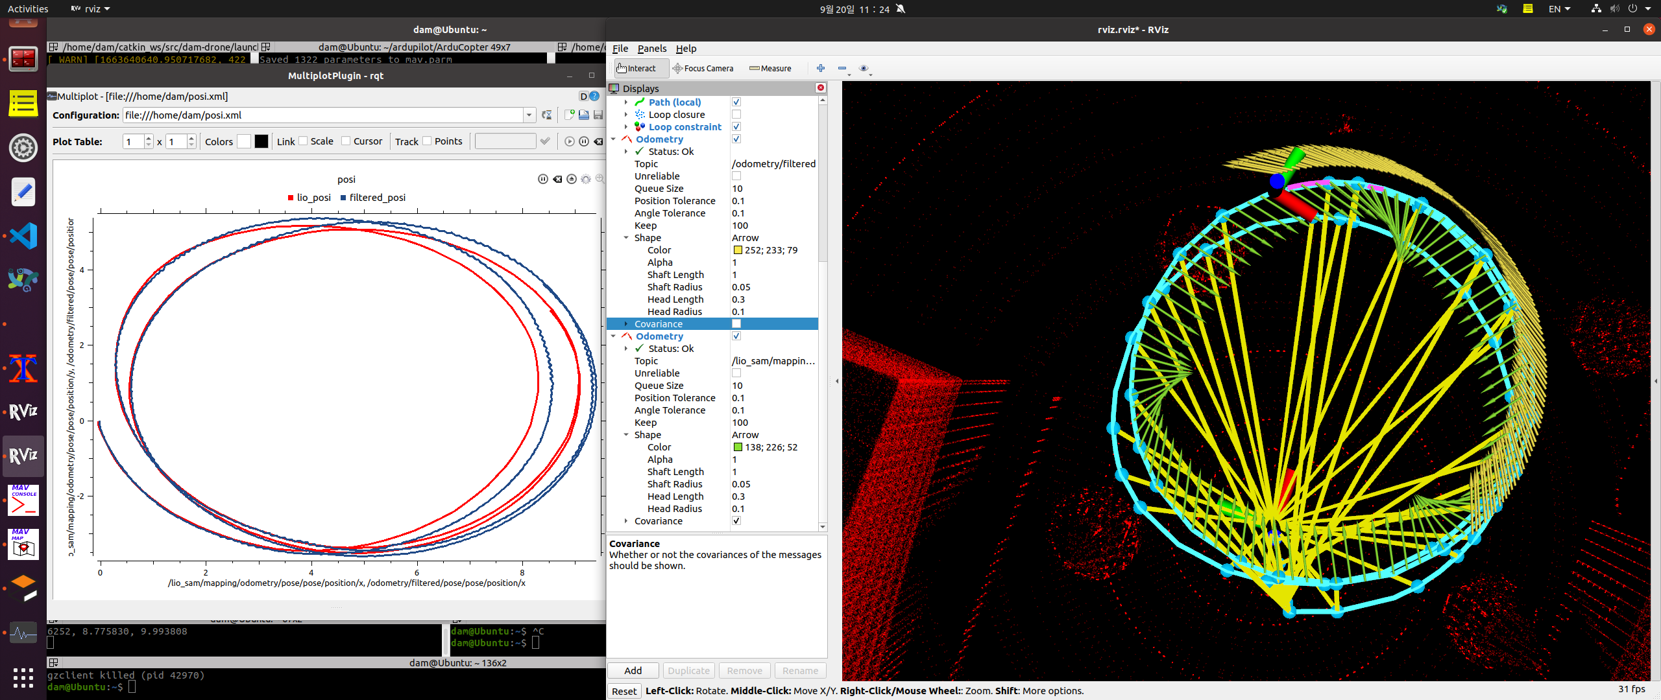
Update rate setting but, 방향 안맞음
Pic. later pose after setting update rate

Slide 11
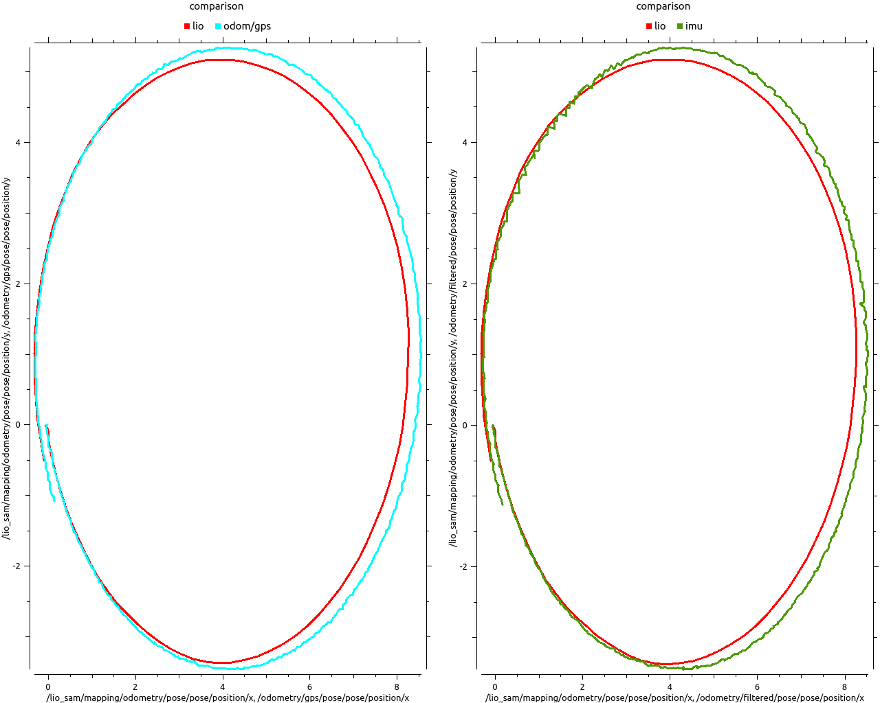
gaussian noise 추가
가우시안 노이즈를 추가하면 방향 오차 없음
Pic. Update rate setting imu 100/gps 50 > gps gaussian noise 0.01

Slide 12
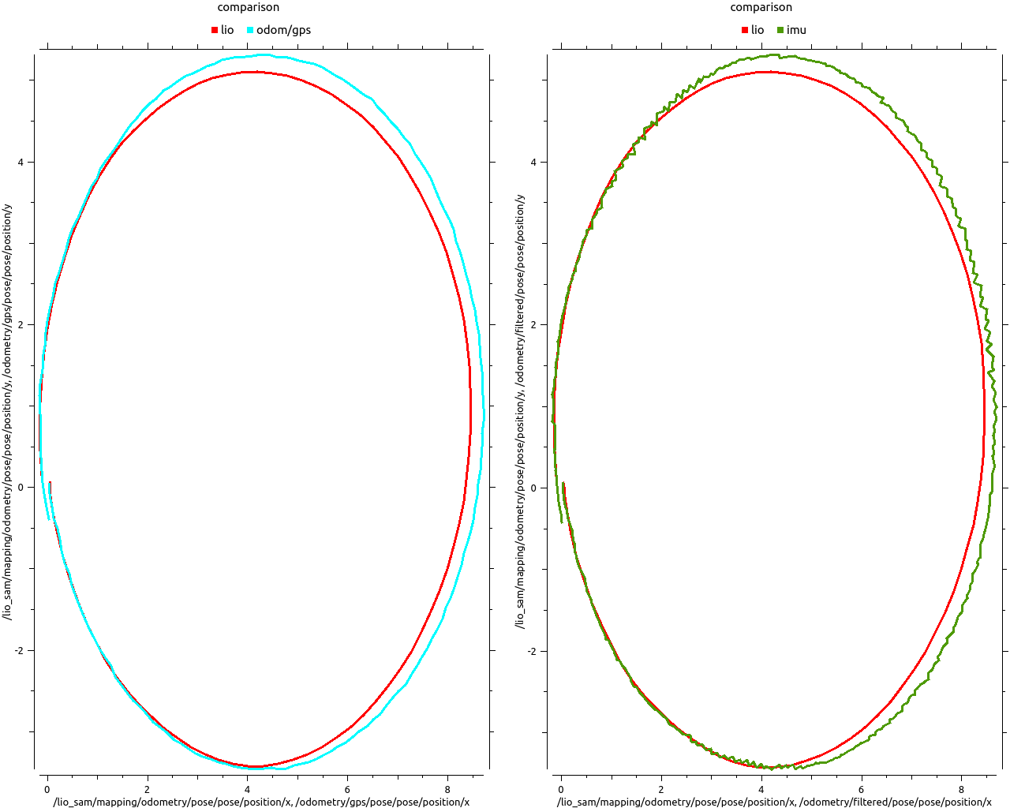
Pic. Update rate setting imu 100/gps 10 > gps gaussian noise 0.01

Slide 13
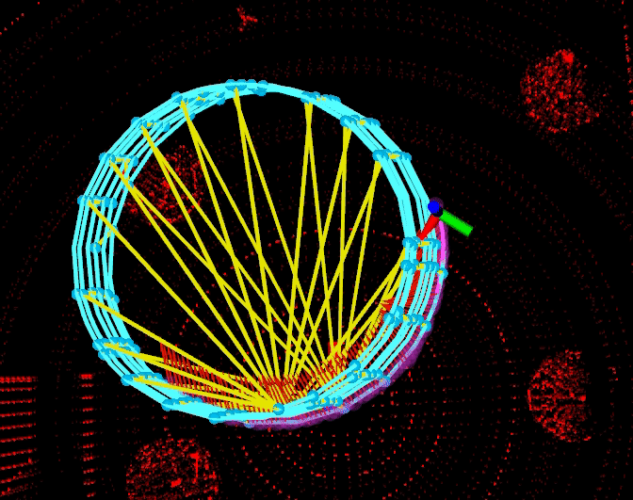
Pic. Update rate setting imu 100/gps 10 > gps gaussian noise 0.01

Slide 14
In, xacro
Update rate
Gaussian noise
Drift
In, Yaml
Queue size
Xxx_pose_rejection_threshold
Xxx_twist_rejection_threshold
Process noise covariance

Slide 15
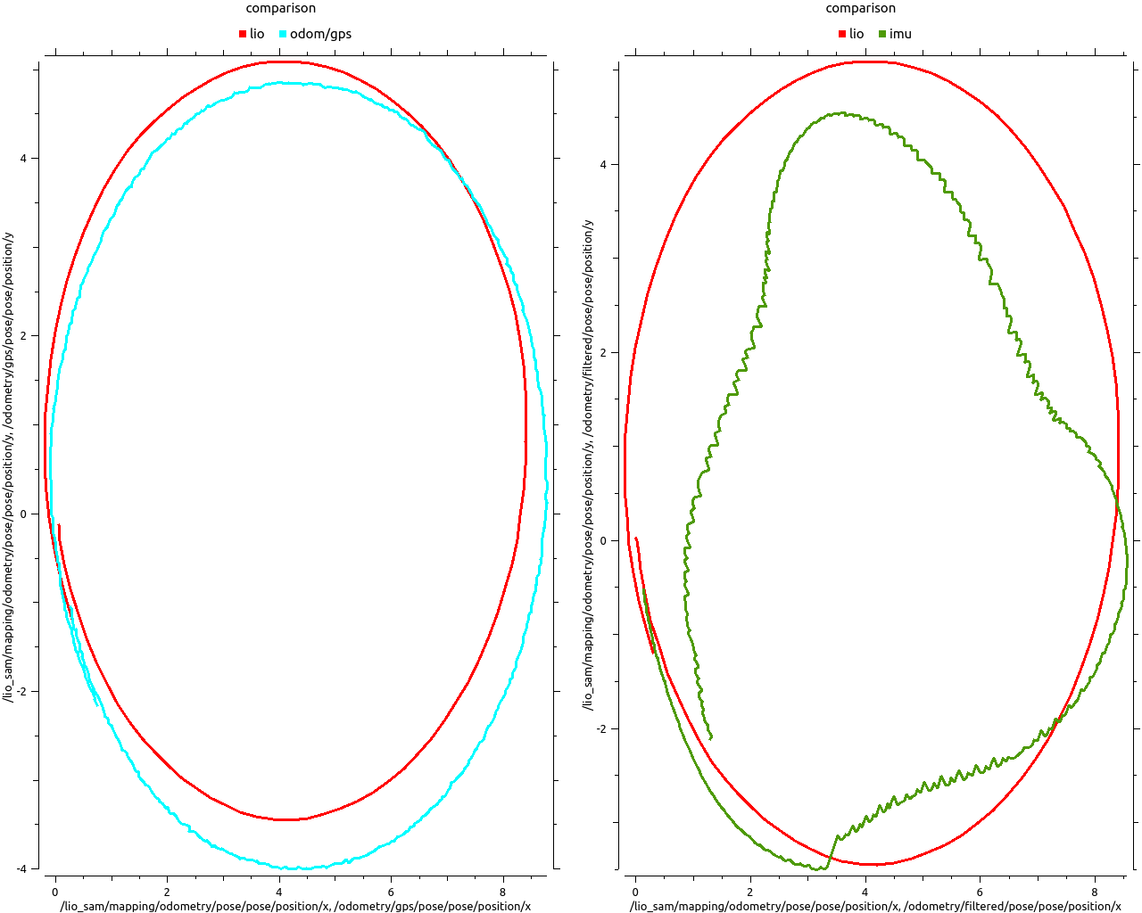
Drift 5 5 5 (gps)

Slide 16
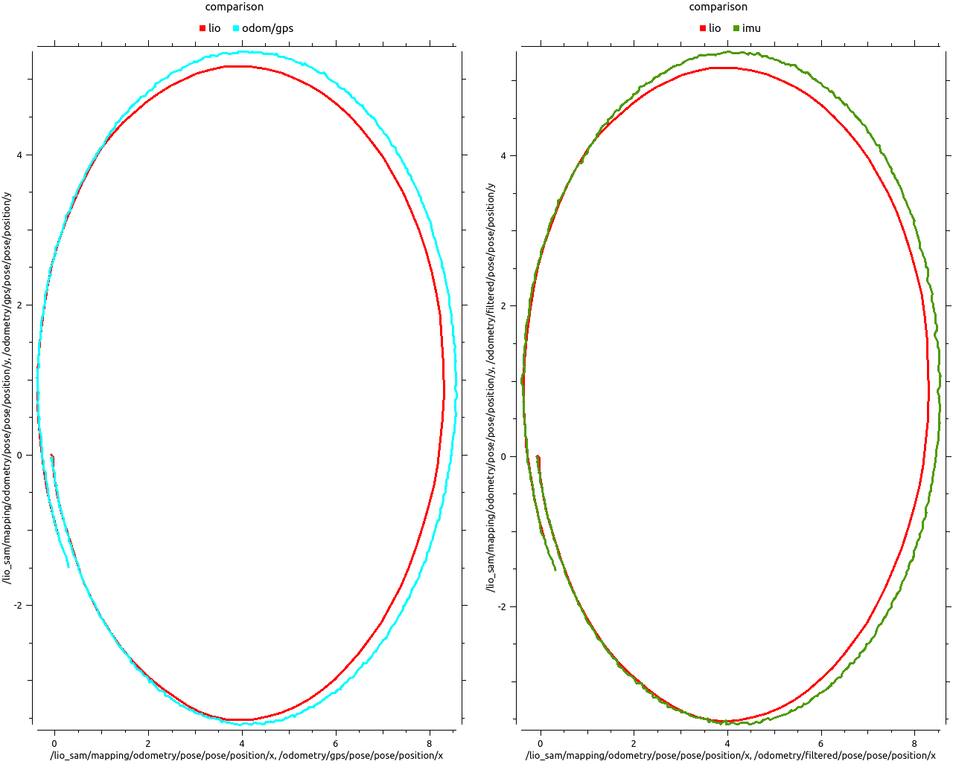
Covariance (x10 > 원래)

Slide 17
In, xacro
Update rate > gps : 50 imu : 100
Gaussian noise > gps : 0.001 > gps튀는 정도
Drift > 0 0 0 > 휘어짐
In, Yaml
Queue size > odom : 5 imu : 2 > 바꿔도 차이 없음
Xxx_rejection_threshold : 마할라노비스거리 기준 > 막 바꾸면 방향 이상해짐 위치는 잘 맞음
Process noise covariance

